Slide 1
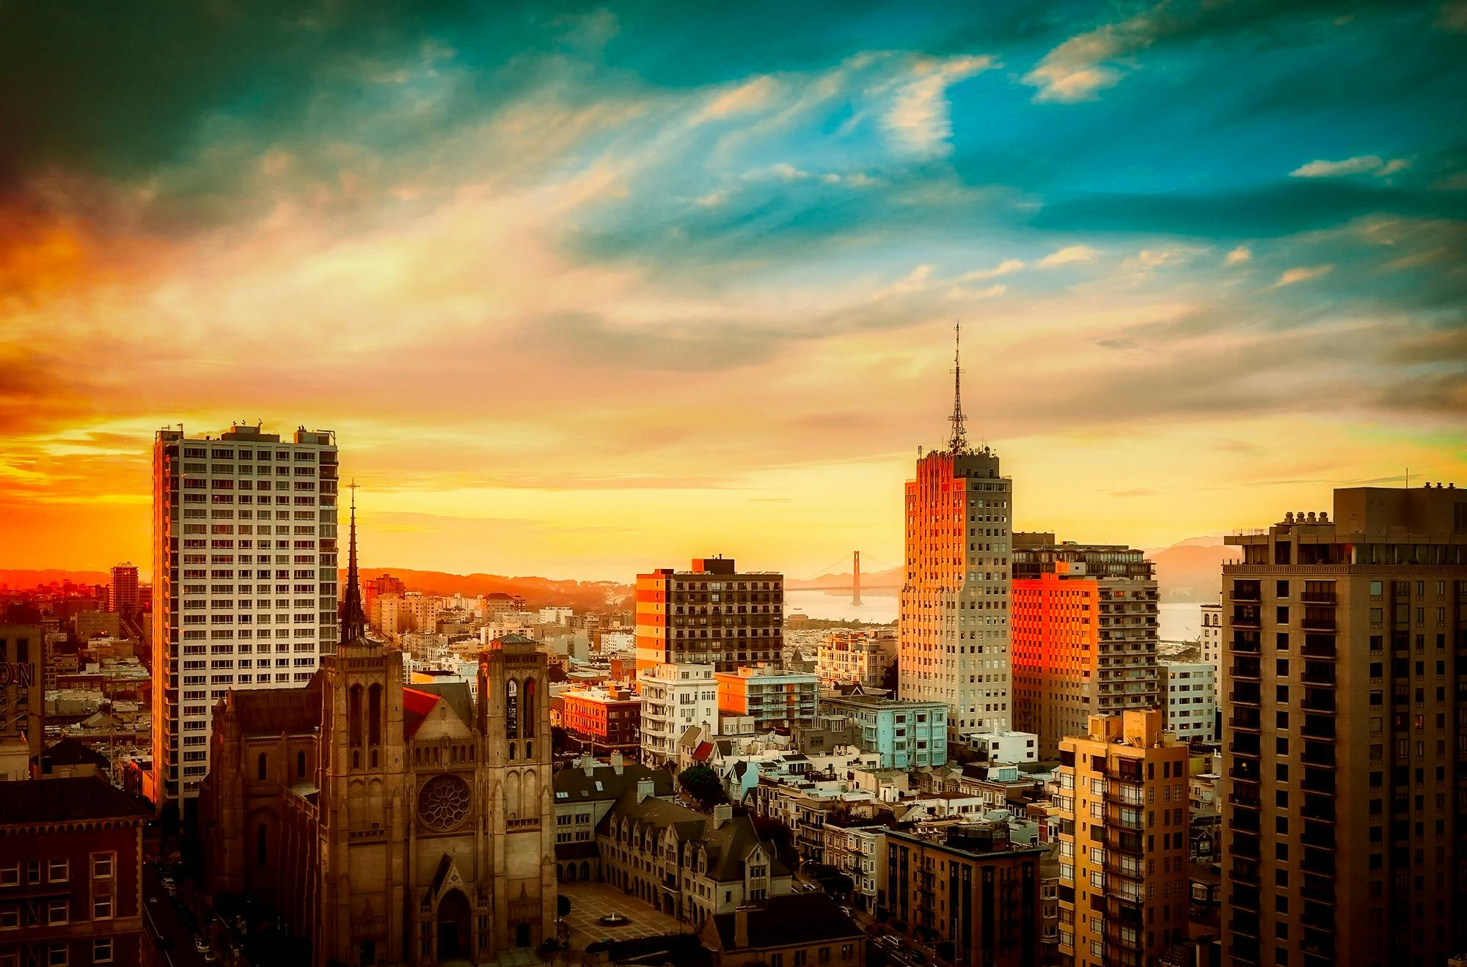
CITY
A city is a human settlement of a notable size. It can be defined as a permanent and densely settled place with administratively defined boundaries whose members work primarily on non-agricultural tasks

